Slide 1

Enhanced Network Security with Machine Learning Based Intrusion Detection

Slide 2

Group Members
Yasaswi Polasi - A04330570
Dharma Reddy Pandem - A04328067
Abhishek Medikonda - A04315522
Sushma Ponugoti - A04319806

Slide 3
Table of Contents
ABSTRACT
LITERATURE SURVEY
INTRODUCTION
LIBRARIES AND DATASETS USED
MACHINE LEARNING MODELS USED
METHADOLOGY
DATASETS FOR NETWORK INTRUSION DETECTION
ANOMALY DETECTION
MODEL TRAINING AND EVALUATION
HYPERPARAMETER TUNING
MODEL VALIDATION
MODEL TESTING
CONCLUSION

Slide 4

Abstract
The goal of this project is to create and evaluate several machine learning models for detecting network traffic using a dataset which is enhanced with information on the characteristics of network traffic. The algorithm carries out thorough preprocessing of the data, which includes robust handling of missing values, suitable encoding of categorical features, and feature selection based on Random Forest Importance. Carefully dividing the dataset into training and testing sets guarantees an objective assessment of the model. A number of classification techniques are investigated, including Decision Trees, Support Vector Classifier (SVC), K-Nearest Neighbors (KNN), Logistic Regression, and Naive Bayes. Using the well-known optimization toolkit Optuna, hyperparameter tweaking for the KNN and Decision Tree models is done with great care. Various metrics, like accuracy, precision, recall, and F1- score, are used to thoroughly assess the models' performance on the test set after they have undergone substantial training on the training set. The outcomes are shown in tabular and graphical forms, along with thorough categorization reports and intricate confusion matrices. The method carefully compares accuracy and recall scores and uses 10-fold cross-validation to robustly evaluate the models' generalization ability. To give a better understanding of each model's consistency, the mean precision and recall scores are reported along with their standard deviations. The KNN model, for example, obtained a mean recall of 99.98% ± 0.0 and a mean precision of 99.98% ± 0.0. The F1-scores for each model are also given, emphasizing the performance of the Decision Tree model, which has the leading F1-score of 100.0%. All things considered, this project provides a thorough and in-depth analysis of several machine learning models for network anomaly detection, with a special focus on fine-tuning hyperparameters and carefully evaluating generalization performance using cross-validation.

Slide 5
Literature Survey
Machine learning (ML) has been widely used for network intrusion detection. Early studies by Gogoi et al. (2013) and Panwar et al. (2014) used traditional algorithms like Naive Bayes and Decision Trees, achieving high detection rates on datasets like KDD CUP '99 and NSL-KDD.
Later, Ambusaidi et al. (2016) and Zhao et al. (2017) employed advanced techniques like Least Square Support Vector Machines (LSSVM), Deep Belief Networks, and Probabilistic Neural Networks, achieving over 99% accuracy on multiple datasets.
Yin et al. (2017) and Roy et al. (2017) compared various algorithms including J48, ANN, Random Forest, SVM, and RNN, with the latter achieving 99.99% accuracy using Deep Neural Networks and SVM.
Recent works by Xu et al. (2018) and Beluch et al. (2018) demonstrated the effectiveness of GRU, LSTM, and ensemble methods like Random Forest on datasets like KDD CUP '99 and UNSW-NB15.
Despite the potential of ML techniques in detecting network intrusions, challenges remain in handling evolving threats, big data, and imbalanced datasets. Current research aims to develop more robust, adaptive, and scalable ML-based intrusion detection systems.

Slide 6

Introduction
Network intrusion detection systems (nids) are security technologies that check network traffic for unauthorized access attempts or suspicious activities.
NIDS are essential for identifying and thwarting attacks that are based on networks, including data breaches, malware infections, and unauthorized access attempts.
NICS can identify the patterns and anomalies that would suggest potential security threats or breach by analyzing the traffic in the network..

Slide 7
LIBRARIES AND DATASETS USED
LIBRARIES:
NUMPY (NP)
PANDAS (PD)
MATPLOTLIB.PYPLOT (PLT)
SKLEARN
DATASET:
The Datasets From Kaggle
https://www.kaggle.com/datasets/sampadab17/network-intrusion-detection
SEABORN (SNS)
WARNINGS
LIGHTGBM
ITERTOOLS
XGBOOST
CGBCLASSIFIER
TABULATE

Slide 8

MACHINE LEARNING MODELS USED
1.Logistic Regression: Logistic Regression is a supervised machine learning algorithm used for binary classification problems. It uses the logistic function to find a model that fits with the data points. The outputs of logistic regression are probabilities that the given input point belongs to a particular class. It is widely used in applications like spam detection, customer retention prediction, and even in advanced fields like neural networks
2. Support Vector Classifier: Support Vector Classifier (SVC) is a powerful supervised learning model used for classification tasks. It works by finding a hyperplane that best divides data into classes. SVCs are effective in high dimensional spaces and are versatile as different Kernel functions can be specified for decision function. They are memory efficient as they use a subset of training points in decision function.
3. K-Nearest Neighbors (KNN): K-Nearest Neighbors (KNN) is a type of instance-based learning algorithm used for both classification and regression tasks. It makes predictions based on the similarity of new instances to instances seen in training phase. KNN is simple to implement and capable of handling multi-output problems. However, it can be sensitive to the local structure of the data.
4. Naïve Bayes: Naïve Bayes is probabilistic machine learning model used for classification tasks. It is based on applying Bayes’ theorem with strong independence assumptions between the features. Despite its simplicity, Naïve Bayes can be surprisingly accurate and is particularly useful for large datasets and real-time prediction.
5. Decision Tree: A Decision Tree is a flowchart-like tree structure where each internal node denotes a test on an attribute, each branch represents an outcome of the test, and each leaf node holds a class label. Decision trees are capable of performing both classification and regression tasks. They are simple to understand, interpret, and visualize. However, they can create over-complex trees that do not generalize the data well.

Slide 9

METHODOLOGY
Data Collection
Preprocessing
Feature Selection
Model Training
Model Evaluation
Intrusion Detection

Slide 10
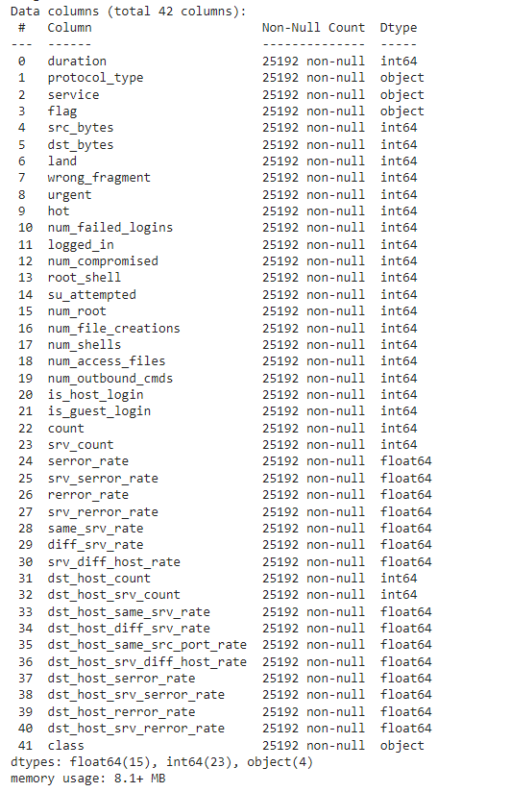
Datasets for Network Intrusion Detection
The dataset that has to be audited was given, and it includes a large range of simulated intrusions in a military network setting. It emulated a standard US Air Force LAN to create an environment for obtaining raw TCP/IP dump data for a network. The LAN was bombarded with several attacks and was focused like a genuine environment. A connection is a series of TCP packets that transport data to and from a source IP address to a target IP address in accordance with a predetermined protocol. The packets start and stop at a specific time interval. Additionally, every connection has a label designating it as either normal or an attack with a single, distinct attack type. A connection record is almost made up of roughly around a 100 bytes.
For each TCP/IP connection, 41 quantitative and qualitative features are obtained from normal and attack data (3 qualitative and 38 quantitative features) .The class variable has two categories:
• Normal • Anomalous

Slide 11
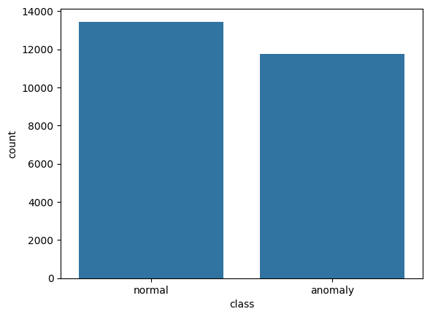
Anomaly Detection
Here, the Visualization helps understand the distribution of network traffic instances in the dataset, which is essential for training and evaluating machine learning models for network anomaly detection

Slide 12
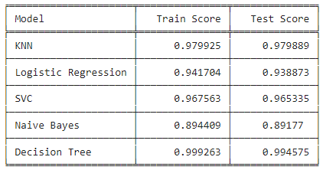
Model Training and Evaluation
Five machine learning models—KNN, Decision Tree, Support Vector Classifier, Logistic Regression, and Naïve Bayes—were trained and assessed for this project. Model training and evaluation made easy by the `fit()` and `score()` functions, respectively. To make performance comparison easier, training and test results were kept track of for every model.

Slide 13
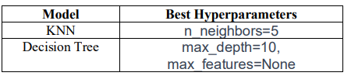
Hyperparameter Tuning
Optuna was used to tune the hyperparameters for the KNN and Decision Tree models. Table II displays the optimal hyperparameters found for each model

Slide 14
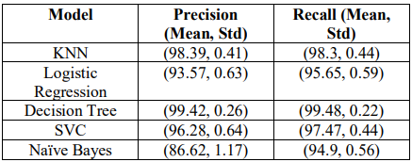
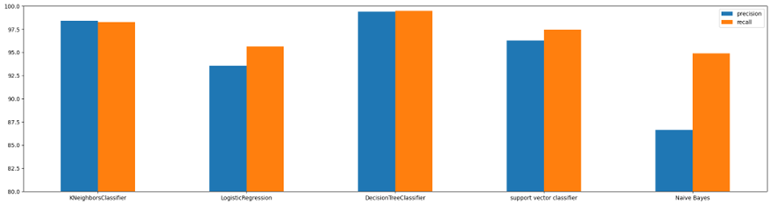
Model Validation
recision and recall were used as the score metrics for crossvalidation, which was used to validate the model. To do cross-validation, the `cross_val_score()` function was used to calculate the scores' mean and standard deviation. This methodology guarantees an exhaustive evaluation of the model's efficacy and furnishes discernments into its coherence among distinct data subsets

Slide 15
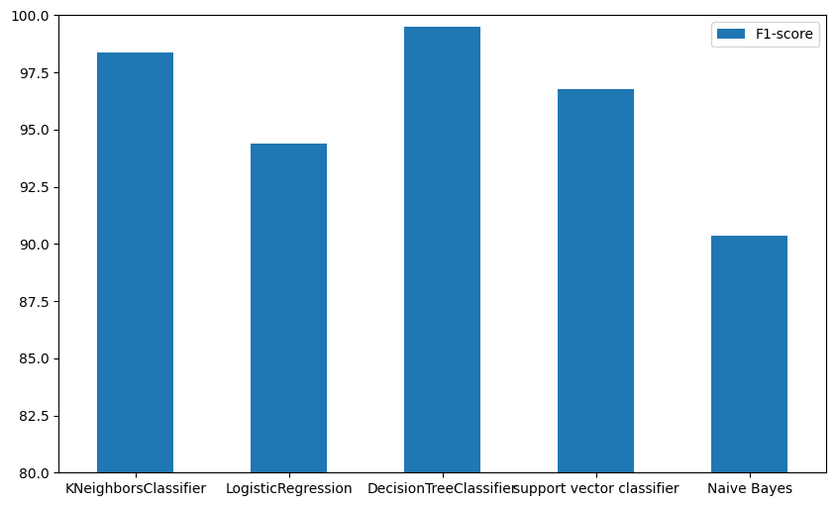
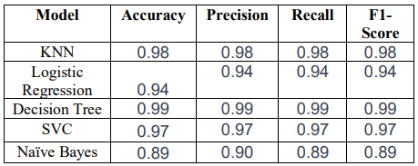
Model Testing
The trained models were put to the test on the test dataset in the last stage. The `predict()` function was utilized to create predictions, which were then assessed for performance using a range of metrics, including the confusion matrix, classification report, and F1-score. To achieve this, the methods `f1_score()}, `classification_report()}, and `confusion_matrix()` were used. To give a thorough picture of the model's performance, the F1-scores were further displayed.

Slide 16
PROJECT DEMONSTRATION

Slide 17
Conclusion
The research used the 1999 DARPA Intrusion Detection Evaluation Dataset to evaluate machine learning methods for detecting cyberattacks on computer networks.
The Decision Tree Classifier performed the best, with an F1-score of 99.12% and a test score of 99.01%.
The study highlights the importance of data preprocessing, feature engineering with Recursive Feature Elimination (RFE), hyperparameter tuning, and thorough model evaluation to achieve reliable Network Intrusion Detection Systems (NIDS).
The KNN model showed the best training and test scores, while the Decision Tree, SVC, and Logistic Regression models also performed well.
The Naive Bayes model performed the least.
The research demonstrates the potential of machine learning models in network security and provides a solid foundation for improving and implementing NIDS in practical situations.

Slide 18

Thank you

